Slide 1
Classification of Rice Variety Using Images of Different Rice Grains
Machine Learning Project
Github link : https://github.com/ayush-mourya/Rice-classification-using-Machine-Learning-and-CNN.git

Slide 2
Motivation
Rice stands as one of the most essential grain products rich in carbohydrate and plays a critical role in human nutrition.
There are different varieties of Rice which differ in appearance , taste and nutrition. So it’s important to distinguish out the varieties on the basis of the customer needs.
Traditionally, assessing these physical features through manual classification methods can be labor-intensive, expensive, and prone to inconsistency.
The implementation of machine vision systems emerges as a viable alternative.
Recent advancements in machine learning and image processing technologies have allowed for a comprehensive analysis of grain products, focusing on critical physical attributes such as color, texture, quality, and size.
These systems offer a non-destructive, cost-effective, and efficient approach to rice quality assessment, significantly enhancing the speed and accuracy of classification.

Slide 3
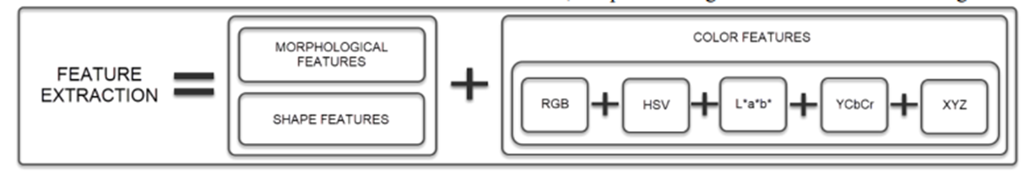
Literature Survey
https://dergipark.org.tr/tr/download/article-file/3060874
https://dergipark.org.tr/en/download/article-file/1513632
In the study, a total of 75 thousand rice grain images were obtained, primarily 15 thousand for each variety of the 5 classes of rice.
Each image was converted into binary image for further feature extraction.
In the study, 12 morphological features were extracted and 4 shape features were obtained by using these morphological features. In addition color features from RGB (red, green, blue) color space to HSV (hue, saturation, value), L*a*b* (L*: lightness, a*: red/green value, b*: blue/yellow value.), YCbCr (y: luminance, cb: chroma blue, cr: chroma red) and XYZ color spaces by performing conversion operations, a total of 90 color features were extracted from five different color spaces.

Slide 4
Literature Survey
Finally, 106 features obtained to reduce the data size were feature selection made by ANOVA, X2 and Gain Ratio tests and the effective features were determined.
The top five features obtained from the rankings were :
Roundness , Compactness , Shape factor_3 , Eccentricity and Aspect Ratio.
Another paper was about taking out all the 106 features and training different models on these dataset (Logistic Regression , Decision tree , Random forest , K - nearest neighbor , Multi level Perceptron and Support Vector Machine).

Slide 5
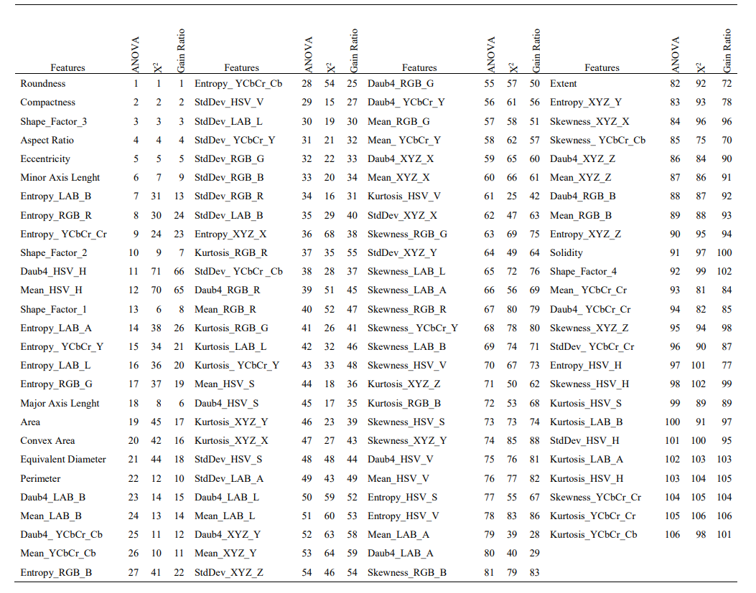

Slide 6
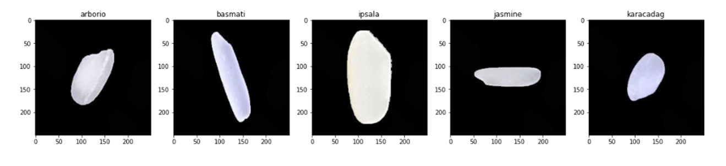
Dataset description
DATASET: https://www.muratkoklu.com/datasets/
•The project utilizes five distinct rice varieties:
Arborio, Basmati, Ipsala, Jasmine and Karacadag.
•Each variety has unique characteristics in terms of grain size, shape, texture, and color, contributing to their differentiation.
Dataset consists of 75,000 images, with 15,000 images per variety. These images capture various features of the rice grains, providing visual data for analysis and classification.

Slide 7
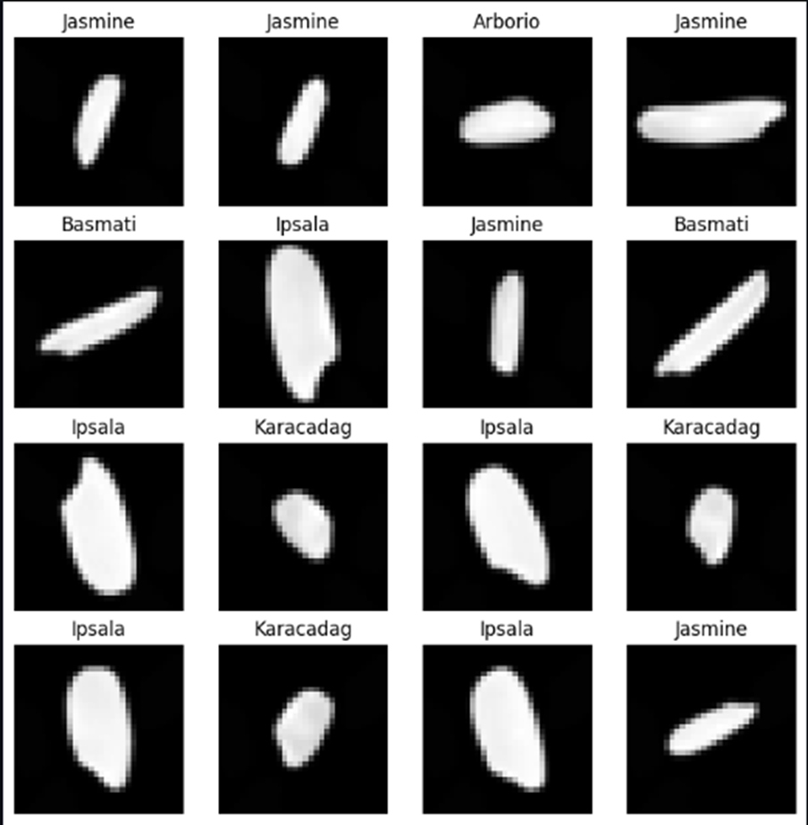
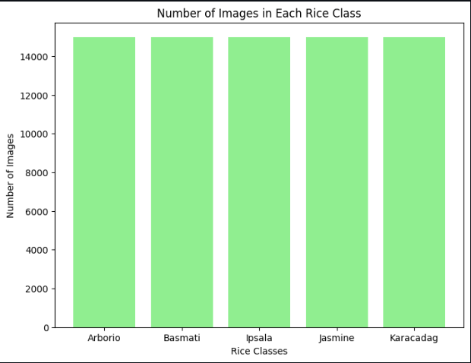
Preprocessing
The dataset is uniform and balanced.So no need for data balancing.Resizing the images to 32*32 pixels. Regardless of the original dimensions, every image was reshaped to fit this size, which standardizes the input for the model.
Randomly flipping the image horizontally which increases the diversity of the dataset.
Converting the grayscale images to the binary image.

Slide 8
Preprocessing
•Normalizes the pixel values.Normalization helps the model learn more efficiently by standardizing the input data.
•Label encoding the target value of rice variety to numerical value and then creating a dataset of 75000 entries with 15000 entries each of 0,1,2,3 and 4.
{'Arborio': 0, 'Basmati': 1, 'Ipsala': 2, 'Jasmine': 3, 'Karacadag': 4}
•Creating train and test data loaders which splits the data into batches of 32 images each . The data is shuffled randomly at every epoch which will avoid overfitting and help in generalizing the data well . Creating data loader helps in memory efficiency and faster execution.

Slide 9
Methodology
Feature Extraction and Model Training on the basis of research paper
• - Morphological and shape feature extraction.
• - Models used:
Linear Regression, Logistic Regression,Decision Trees,
Random Forest, K-Nearest Neighbor,SVM , MLP
Feature Extraction and Model Training after evaluating the first experiment.
• - Area , Perimeter , Major axis length , Minor axis length feature extraction.
• - Models used:
Linear Regression, Logistic Regression,Decision Trees,
Random Forest, K-Nearest Neighbor,SVM , MLP

Slide 10
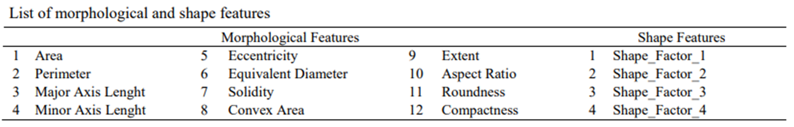
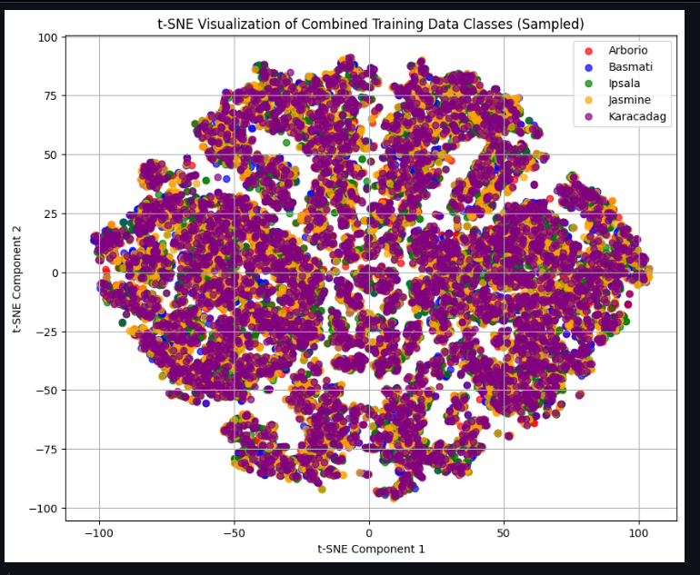
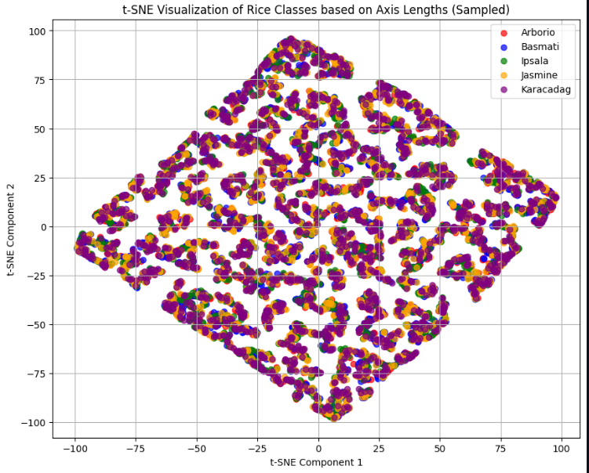
Feature Extraction
•Total 16 features(morphological and shape) were extracted as given in the research paper and additional 4 features suggested by chatgpt (color histogram , hog , lbp , edge,features).

Slide 11
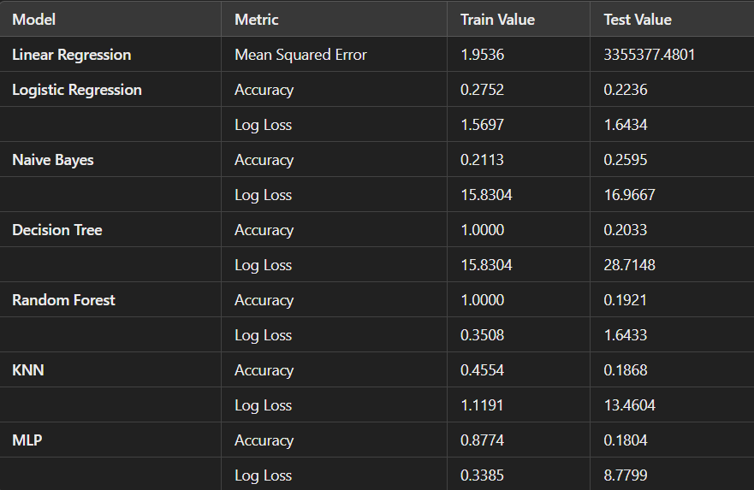
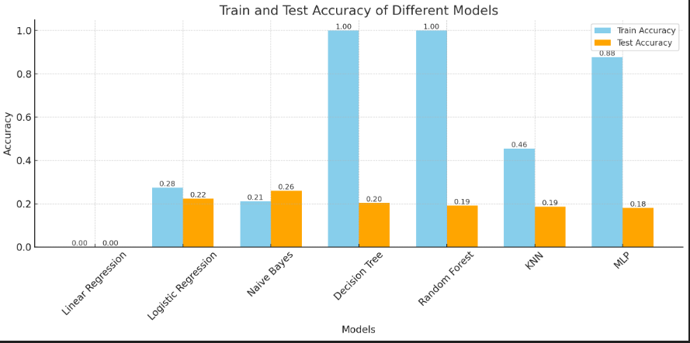
Model Training and Results on the basis of research paper implementation

Slide 12
Analysis
With the failure of linear classifier models, it is evident that due to the high dimensionality of the data, achieving linear separability is challenging in such a high-dimensional space. Therefore, models based on ensemble learning and clustering should be considered.
However, in our case, ensemble learning models like decision trees and random forests have completely overfitted the data, achieving 100% accuracy on the training set but showing low accuracy on the testing set. This indicates poor generalization to unseen data.
In the case of KNN, both training and testing accuracies are very low, suggesting that the model failed to predict clusters in the feature space. This may be due to the high dimensionality of the data, which could have resulted in overlapping class clusters.
The same reasoning can be applied to the MLP,Naive Bayes models and Logistic Regression , as the high dimensionality and feature overlap likely contributed to their poor performance.
Another drawback is high overlapping of classes which is due to large number of features that needs to be minimised.

Slide 13
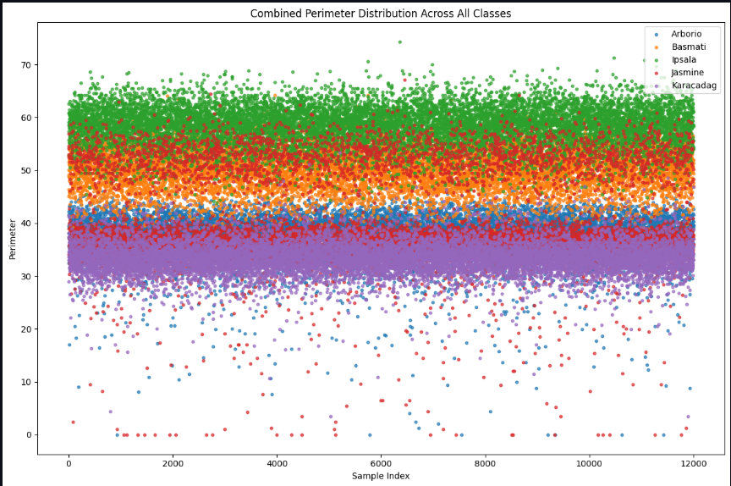
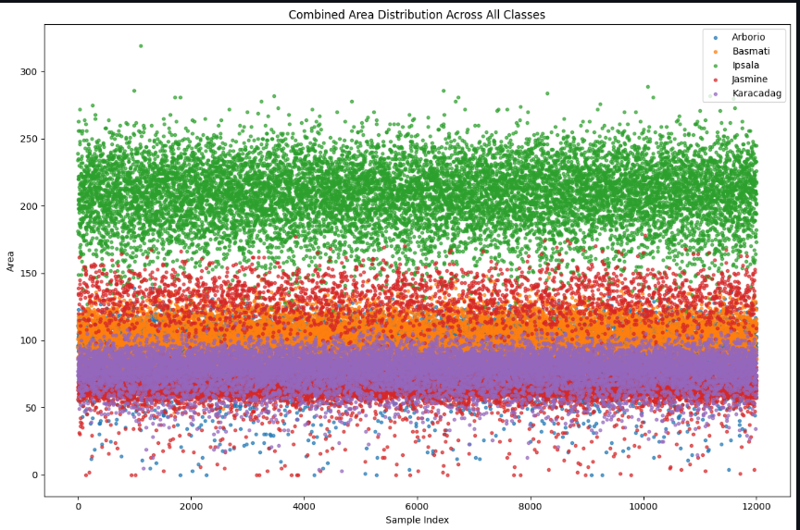
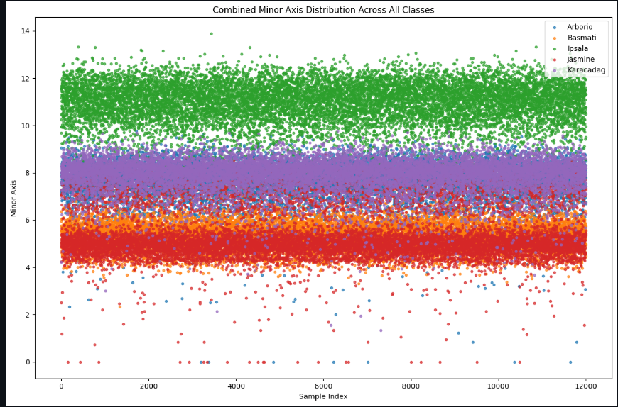
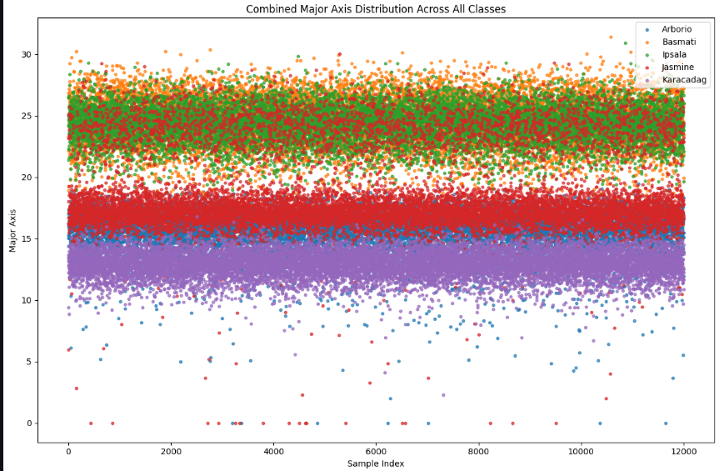
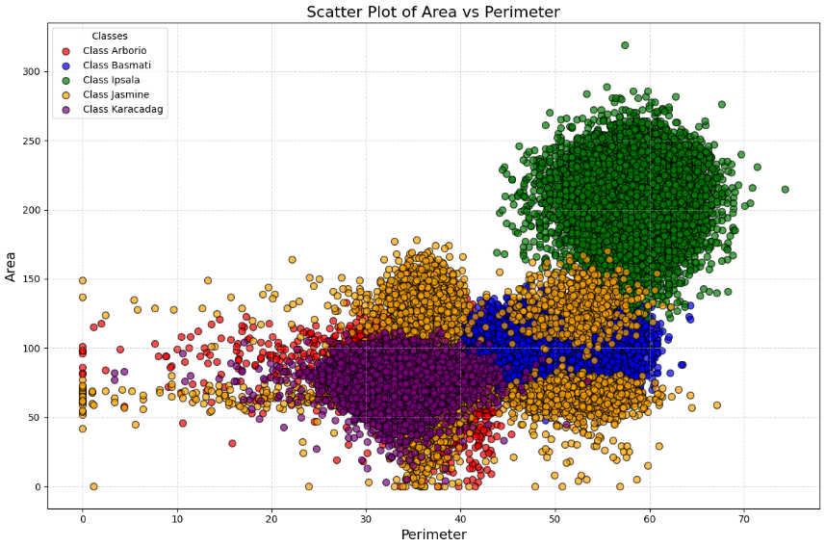
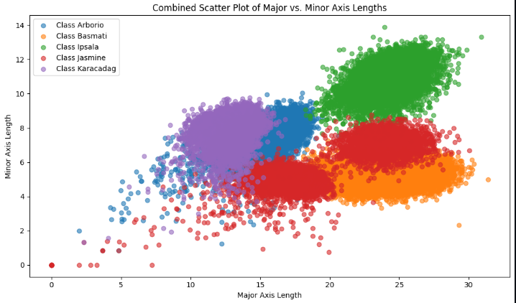
Feature Extraction after poor evaluation of the first procedure
Features extracted :- Area , Perimeter , Major Axis length and Minor Axis length
Perimeter Area Minor Axis Length
Major Axis length Area vs Perimeter Major vs Minor Axis length

Slide 14
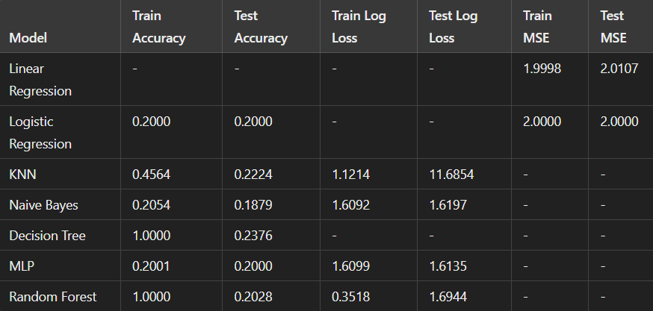
Model Training and Results
Performance does not improve with new features as well even when there is more separability in the clusters than before.We are still getting very low test accuracy.

Slide 15
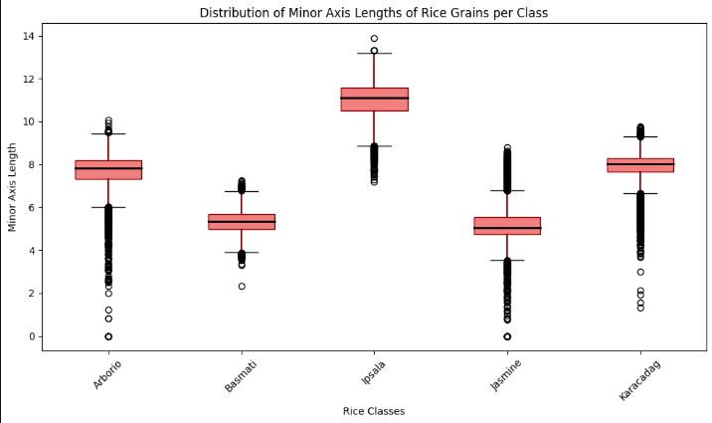
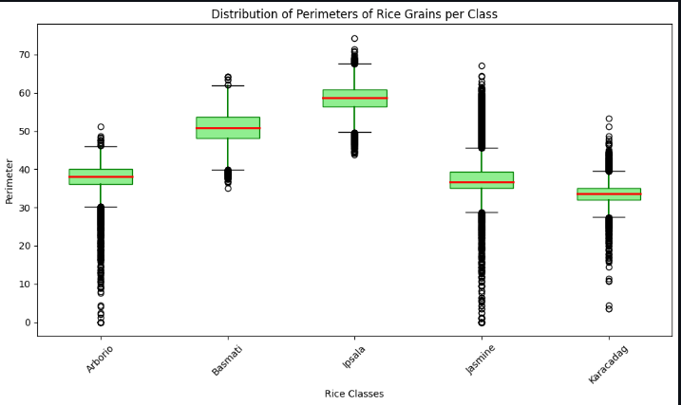
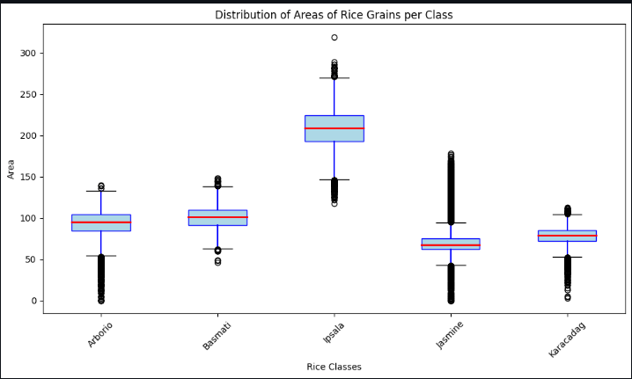
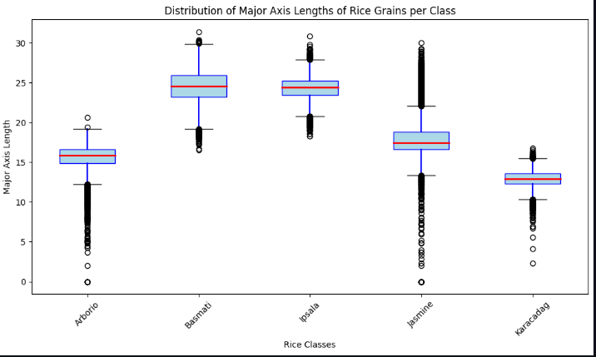
Further Analysis
Minor Axis length Perimeter Area
Major Axis Length
After creating box plot of all the features , we can see that there are a lot of outliers in
every feature.However outliers on the basis of area , perimeter and lengths should
not exist in the same species of rice.Therefore we need to remove these outliers.

Slide 16
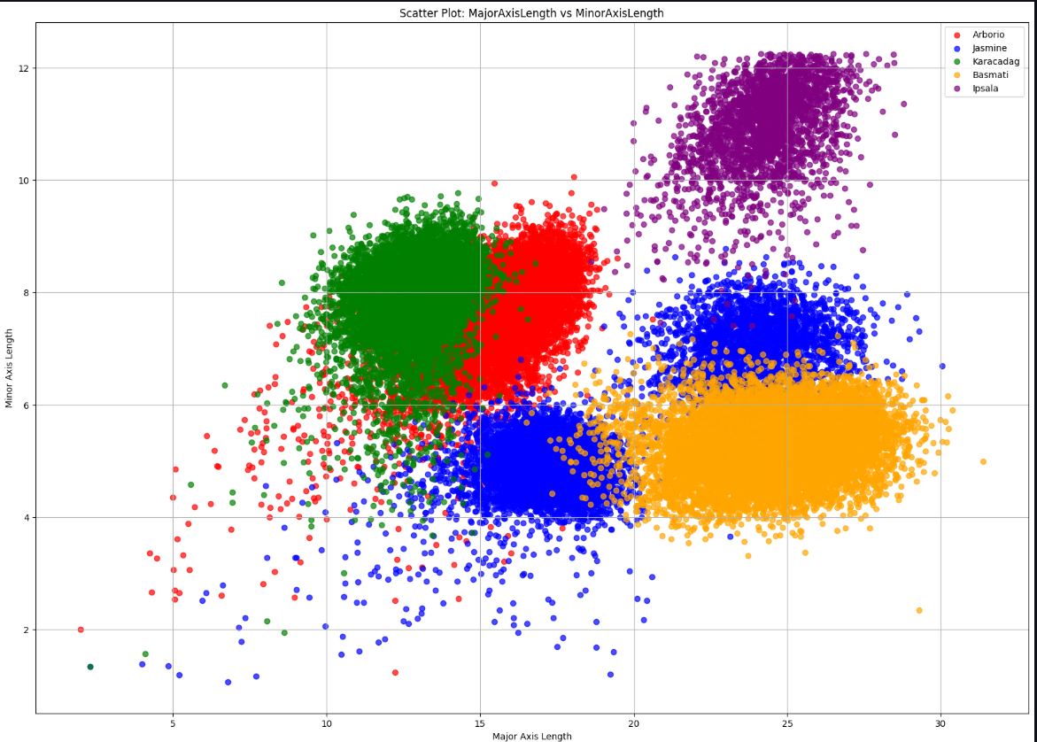
After removing outliers
After removing outliers . the separability between the classes is improved much more than before and the training dataset gets reduced from 60000 entries to 50000 entries.

Slide 17
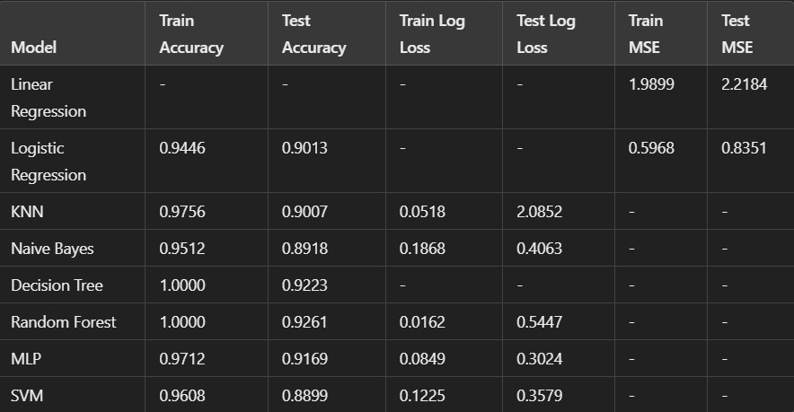
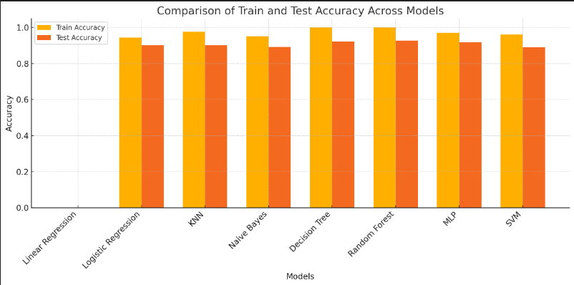
Model evaluation and Results after removing outliers
After removing outliers

Slide 18
Conclusion
After removing the outliers , we finally achieved great accuracy on the test data.
As said before that we should use ensemble learning and clustering based model for this task as linear models would not work due to high dimensions of image data.
We are getting test accuracy in the range( 88% - 92%) and training accuracy in the range(94% - 100%) on all the models (logistic regression, Random forest,Decision Tree , SVM , MLP and KNN).
This shows that training data had a lot of outliers.
Also one thing that can be conclude from this activity is that higher the number of features , more is the overlapping between the clusters of different class.
Removing outliers was based on the idea that rice grains that belong to the same variety must have similar shape and size features.Therefore removing them was important.

Slide 19
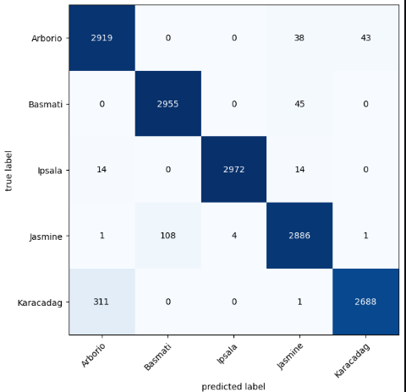
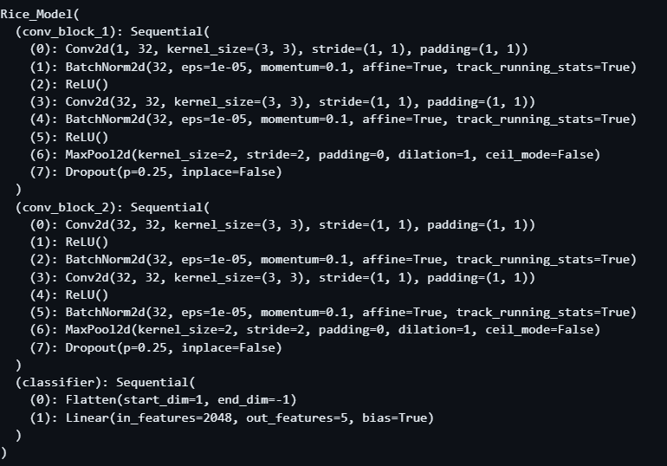
Further improvements
We used CNN for further improvements and there we achieved 96.12% accuracy on the test data.

Slide 20
Timeline
•Timeline followed:
- Preprocessing completed.
- Feature extractions done based on the research paper.
- Model training done using all the models i.e. Linear regression , Logistic
Regression , Decision Tree , Random Forest , KNN , SVM and MLP.
- Use of CNN at last.

Slide 21
Individual team members’ contributions
Bhaskar Kashyap: Feature extraction of Research Paper, Model training , CNN
Ayush Kumar Mourya: Literature survey, Clustering Analysis ,Outlier Removal , Model training and analysis after outlier removal
Daksh Yadav: Preprocessing,Linear and Logistic Regression, report making, ppt ,
Ayush Kumar: Report, ppt, Preprocessing , Linear and Logistic Regression

Slide 22
Thank You

